Slide 1

Welcome to our
Annual General Meeting
Friday 30th September, 2022
3.45pm
School Activity Hall

Slide 2
Agenda
Introductions/Apologies
Agree Last AGM Minutes
AGM Report
Election of New Committee Members
Year 6 Leavers 2023 Event
AOB

Slide 3
Introductions/Apologies
Current Committee Members are –
Chair – Helen Hickmott
Ordinary Committee Member – Elina Ivanova

Slide 4
2021 AGM Minutes
Agree Last AGM Minutes

Slide 5
AGM REPORT –
Who We Are
FOMP is a Friends of the School Association and a registered charity.
Founded in October 2000
We follow the Parentkind Constitution and have a core committee who are also the trustees.
FOMP is a partnership between Parents/Carers, Staff Members and any person wishing to offer appropriate support/help that is accepted as a member by the committee.
The object of the association is to develop effective relationships between the staff, parents and others associated with the school and engage in activities or provide facilities or equipment which support the school and advance the education of the pupils.

Slide 6
Events Held This Year -
Halloween Trail & Treat Bags- £355.43
Xmas Cards & Santa Sacks – School Fundraising - £321.01
Winter Bags - £132.15
2022 Challenge - £710.59 (Plus Gift Aid being claimed)
Second Hand Book Sale - £136.68
Someone Special Sale – £100.59
Easter Hunt - £235.41
Break The Rules Day - £637.35
Circus Event - £1937.99
Total profit raised from these events - £4567.20

Slide 7
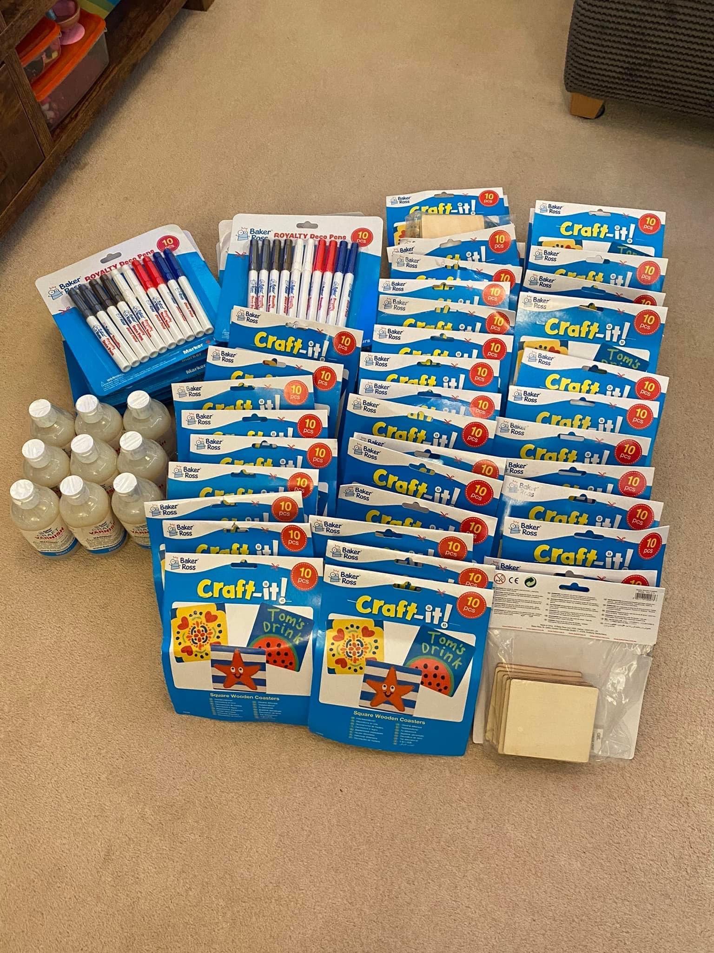
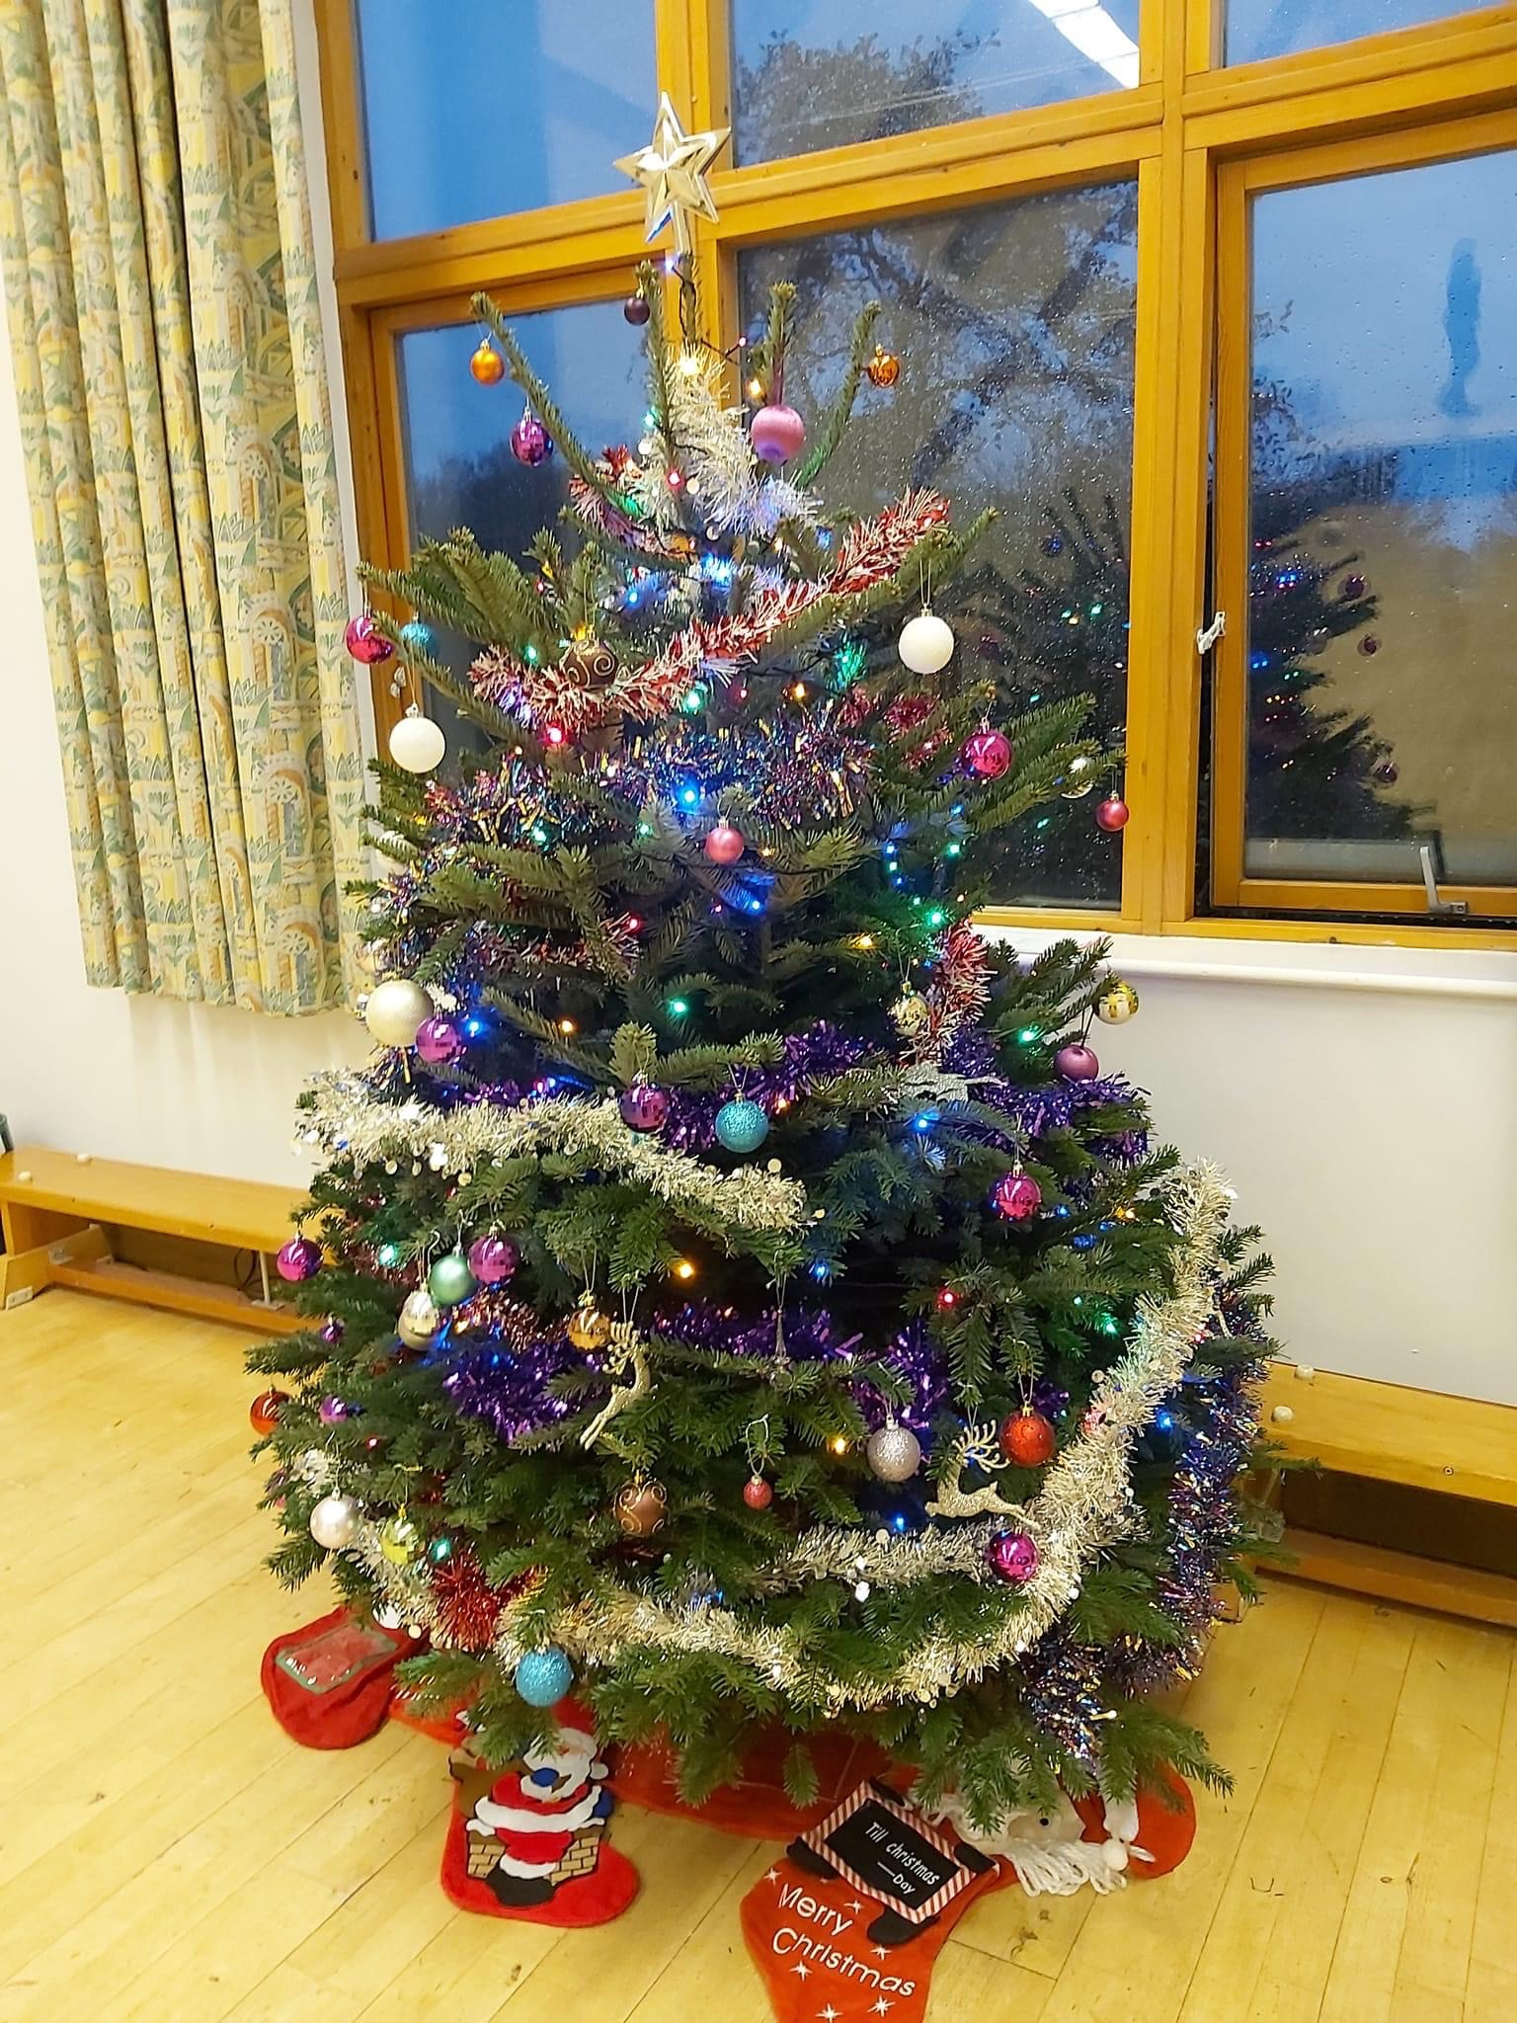
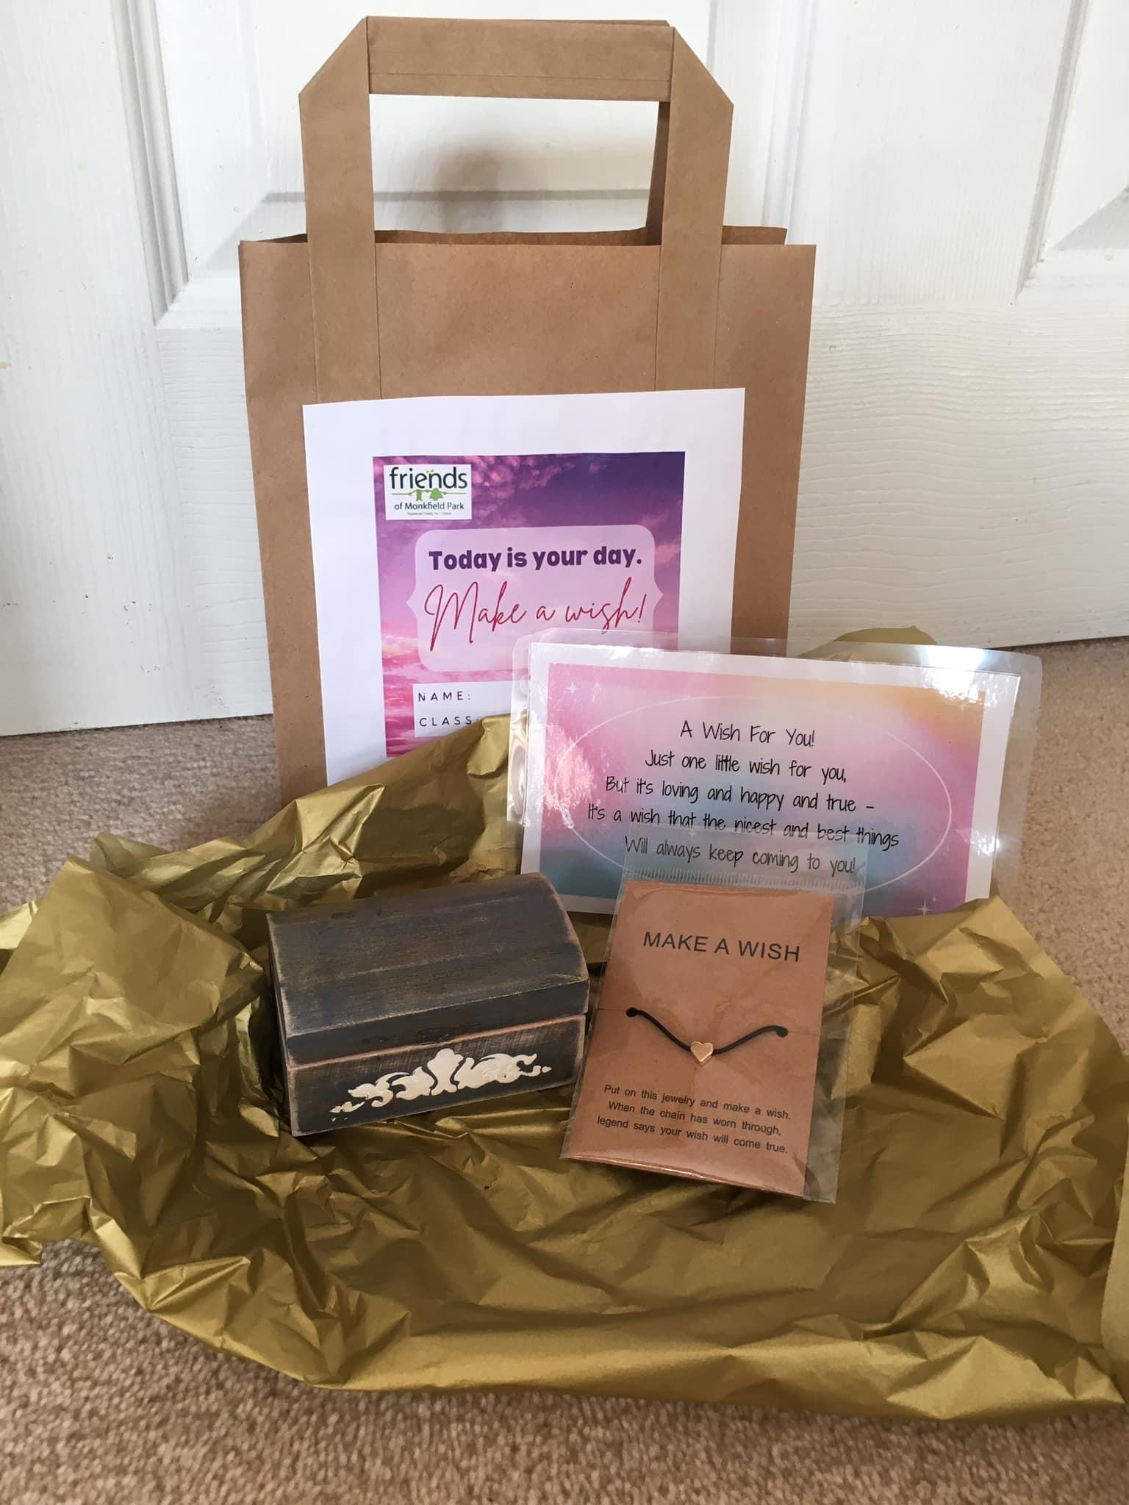

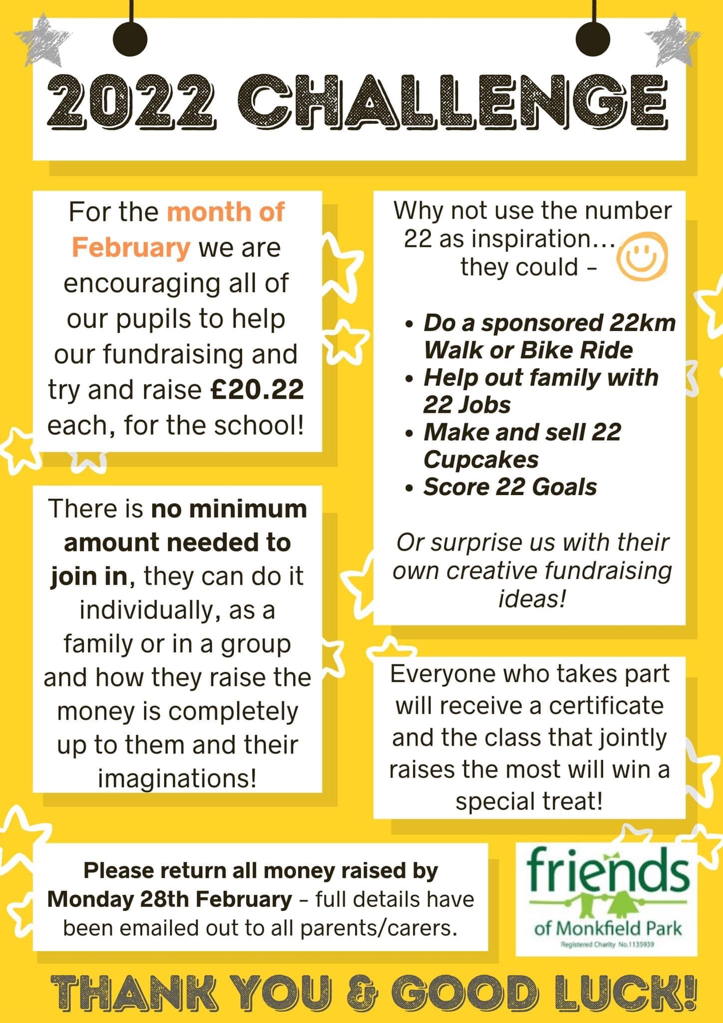
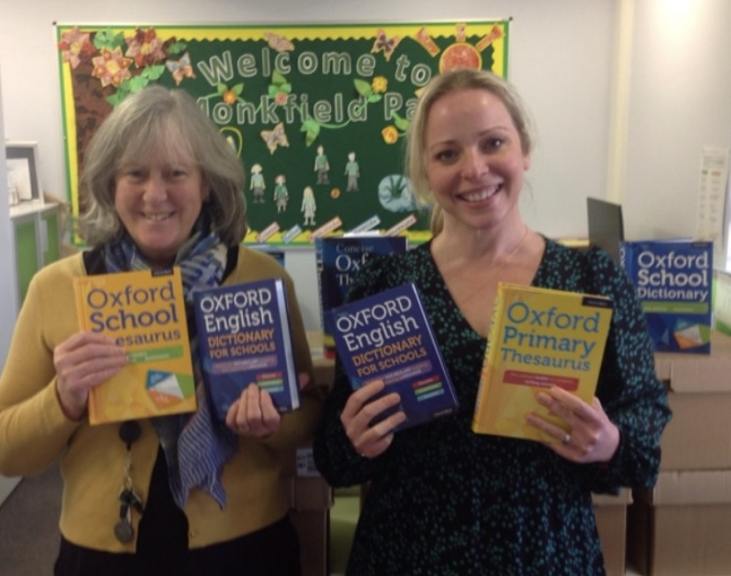

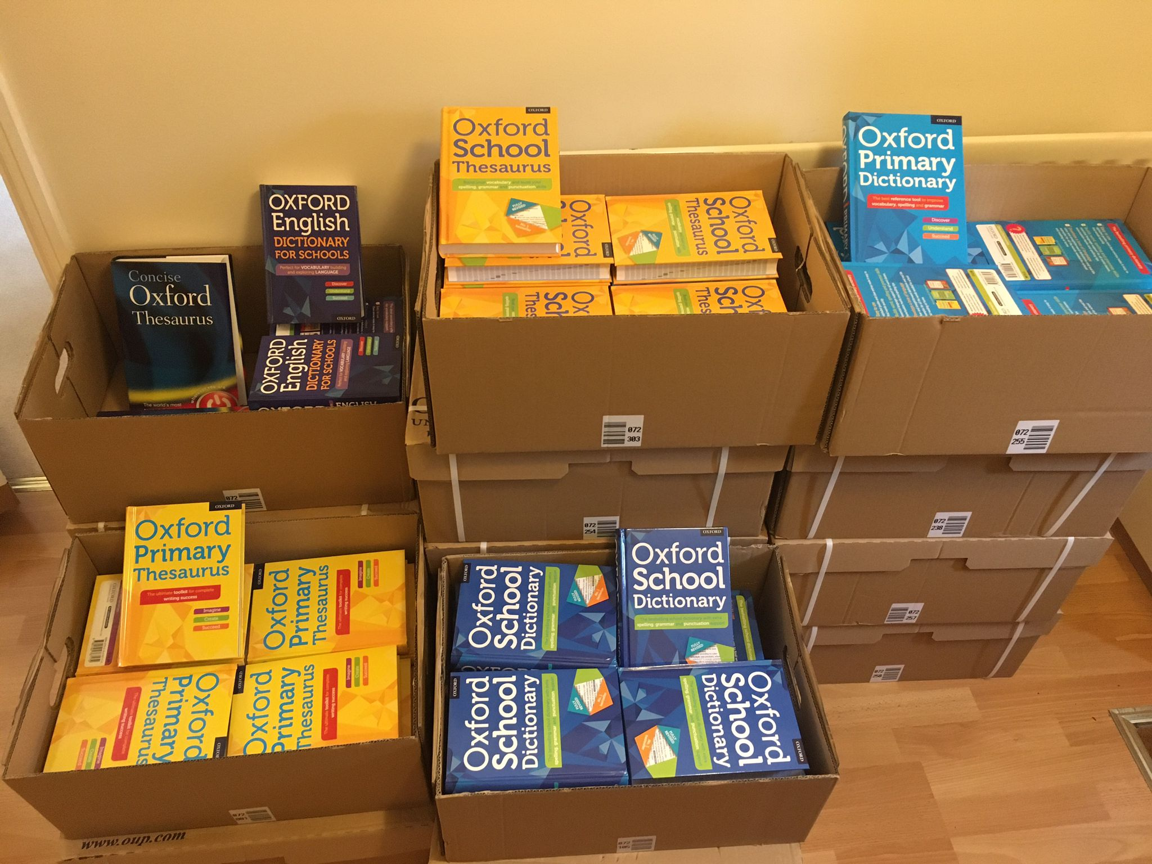


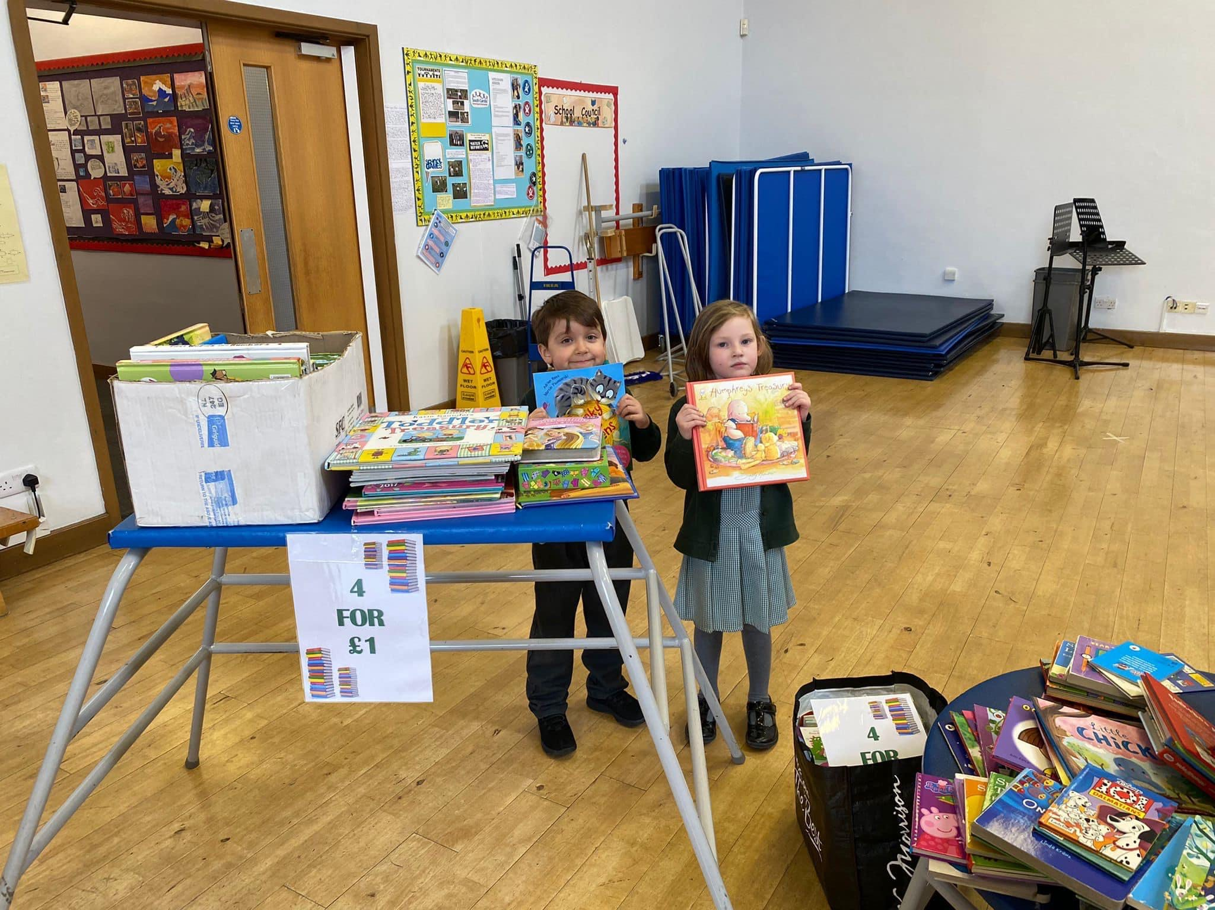
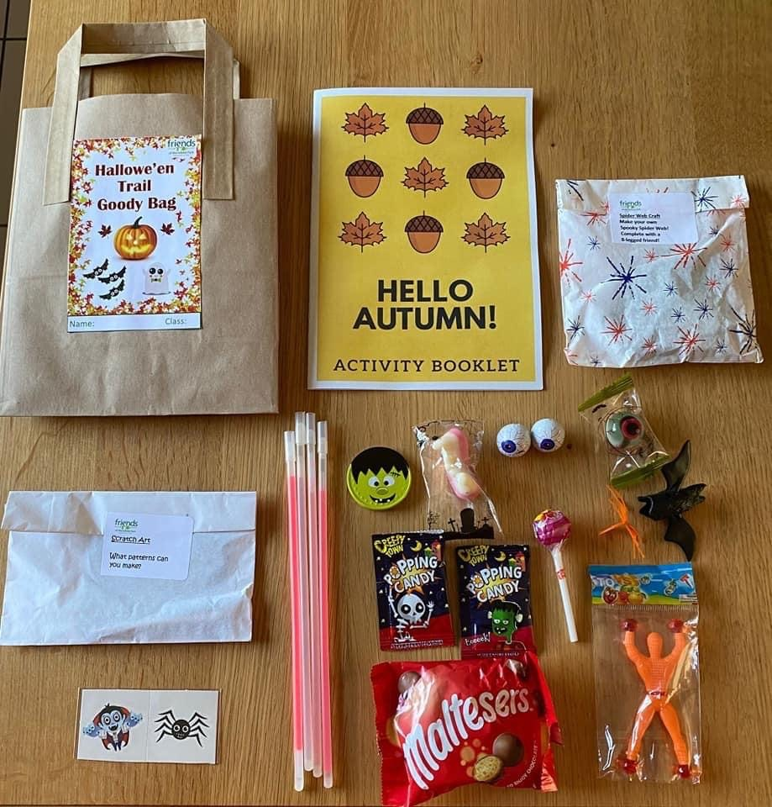
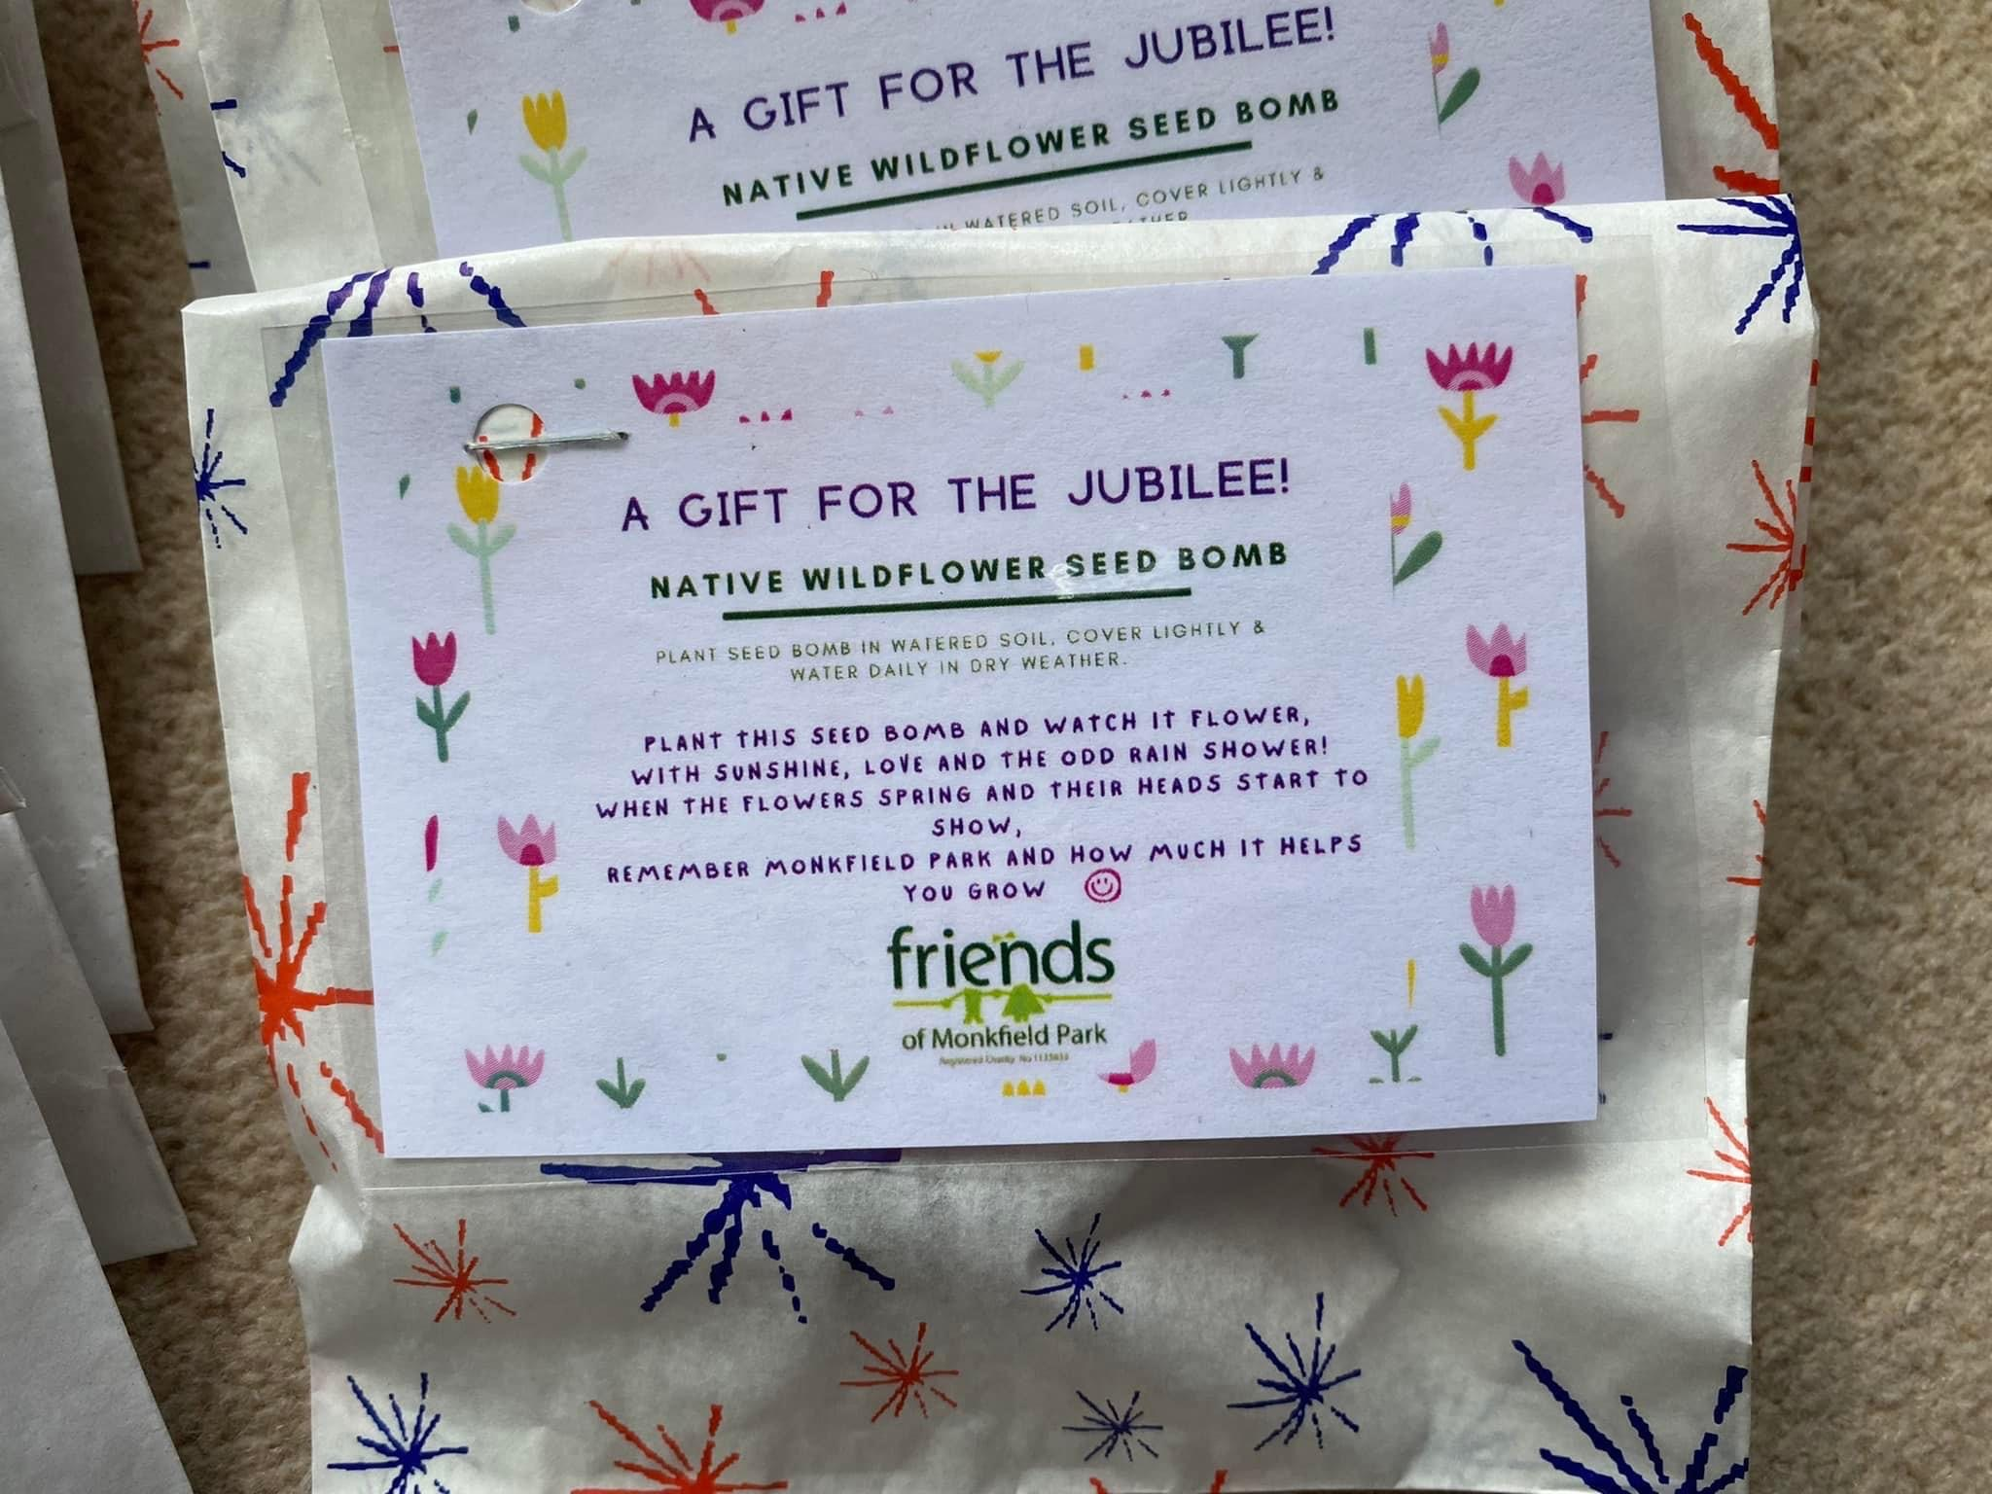

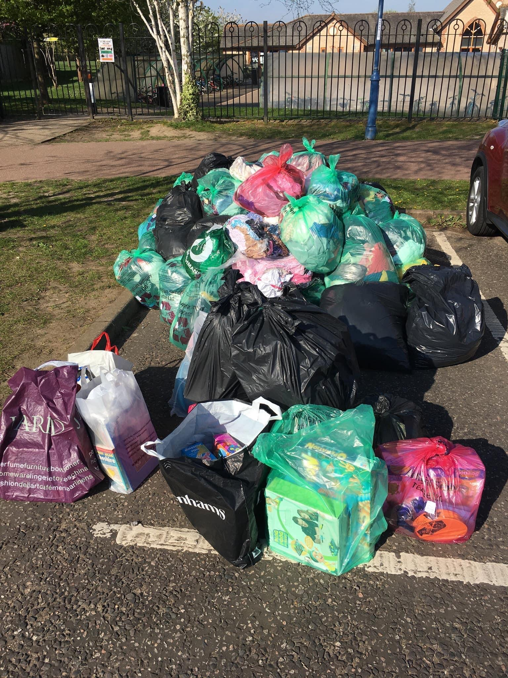
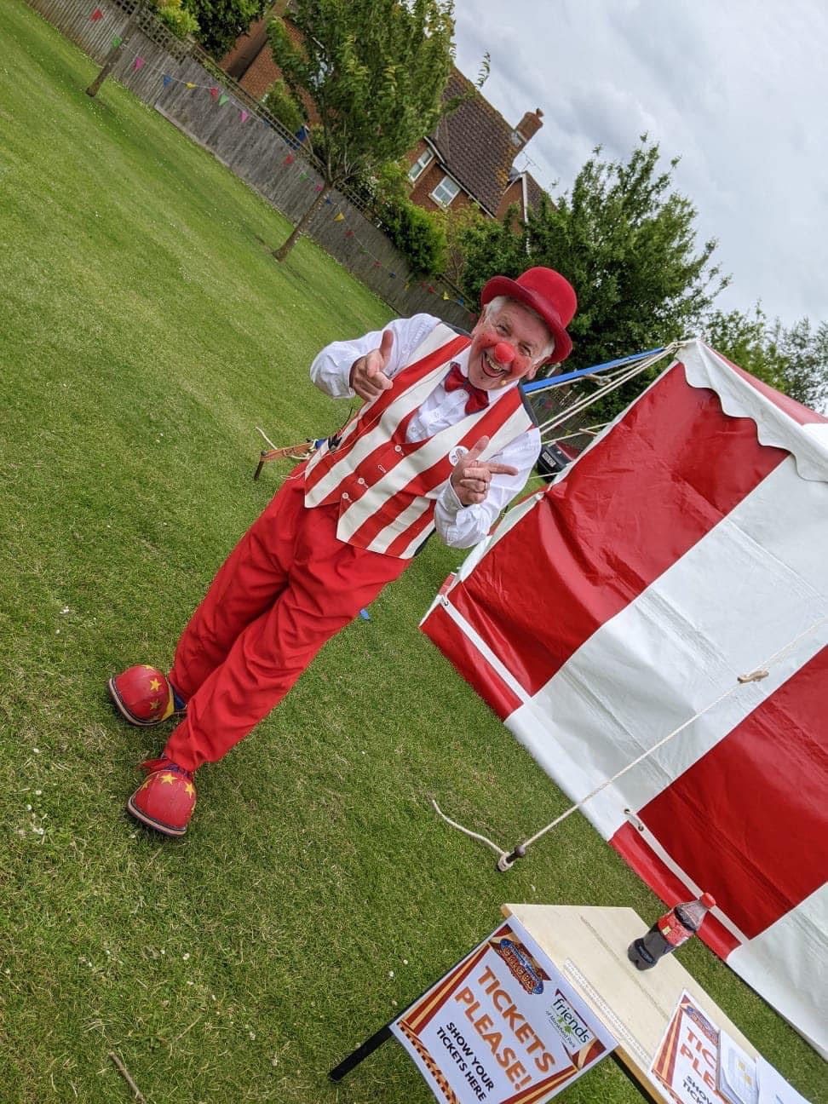
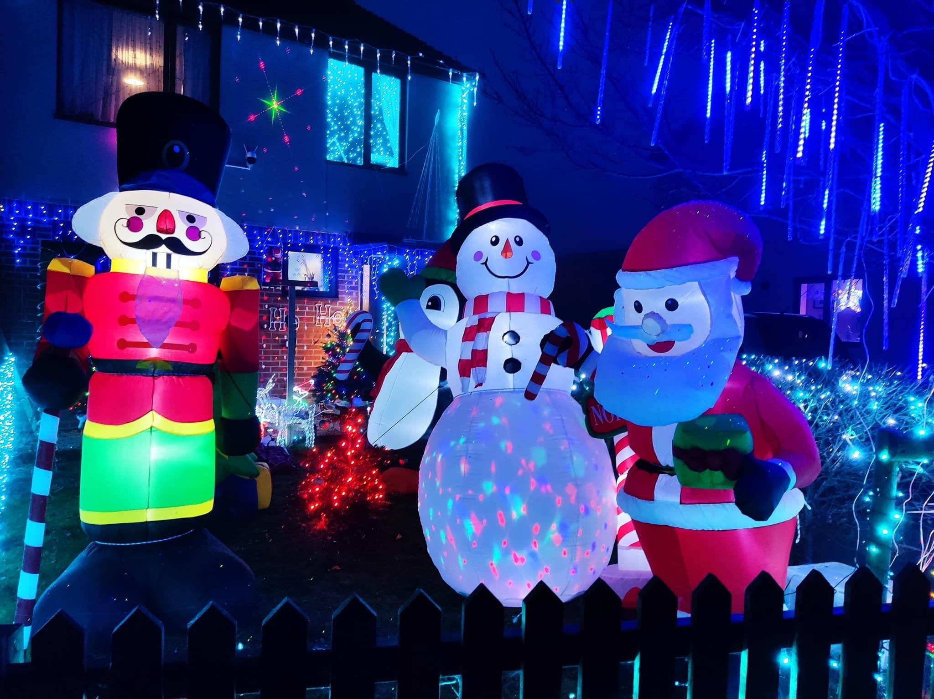
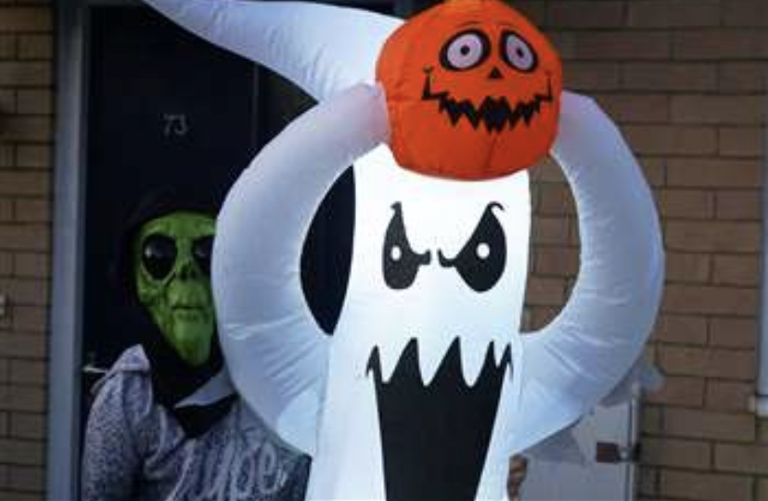

Slide 8
Fundraising for Charities and External Donations Received
We helped collect £500.36 this year for Children In Need and an amazing £1152.47 for Red Nose Day!
We are also very grateful to have received the following donations this year –
Miscellaneous Parent/Carer Donations - £354.35
Playground Markings Renewal Fund - £69.33
Reflection Garden - £29.62

Slide 9




Ongoing Fundraisers
EasyFundraising - £77.90
Amazon Smile - £177.06
Stamptastic - £4.25
Cash For Clothes - £480
Second Hand Uniform Sales - £648
These have raised a total of £1387.21 this year.

Slide 10
Where Does The Money Go?
We have donated £4269.96 to the school this year in various ways, which includes the following :
    Reflection Garden Mosaic Piece
    Christmas Tree for the Main Hall
    Gifts for the Christmas Lunch
    Christmas & Welcome Gifts for Reception Children
    Guided Reading Books/Writing Week Books
    Dictionaries/Thesauruses for the Whole School
    Ice Lollies for Sports Day
    Donations to the C&LC
    Jubilee Crafts for the Whole School
    Seed Bombs – Jubilee Gift – Whole School
    Ice Pops – End of School Year – Whole School
    Reflection Garden –
    The total that is currently held in our account for completing the Reflection Garden is £839.24 after paying for the Mosaic last year.
    Year 6 Leavers 2022 –
    FOMP provided a donation of £500 towards the Leavers celebrations.

Slide 11
What’s Next?
Upcoming Events –
  Halloween Event
  Xmas Cards
  Xmas Event
  Santa Visit for Reception & C&LC
  Disco
  Second Hand Book Sale
  Easter Event
  Break The Rules Day
  Summer Event
  Frozen Fridays!
Future School Projects -
  We are currently purchasing the 50 Top Recommended Reads for each Year Group.
  New Trim Trail & Outdoor Play Equipment for the Main Field.
  Increasing the amount given each year towards Coach costs for school trips.

Slide 12
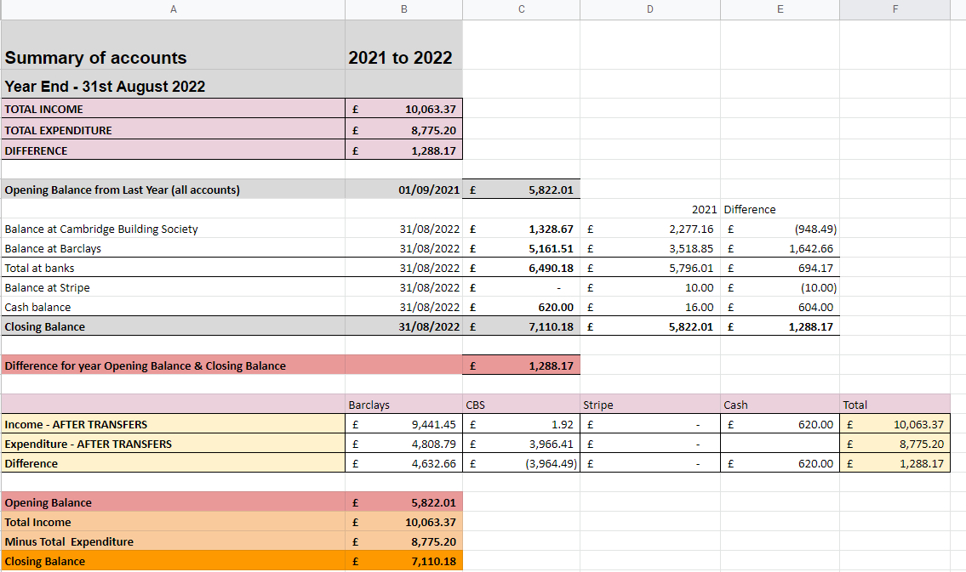

Slide 13
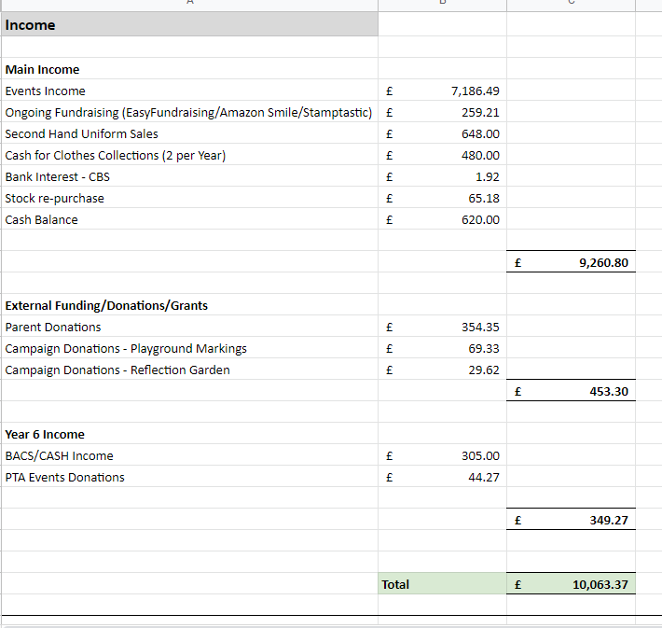

Slide 14
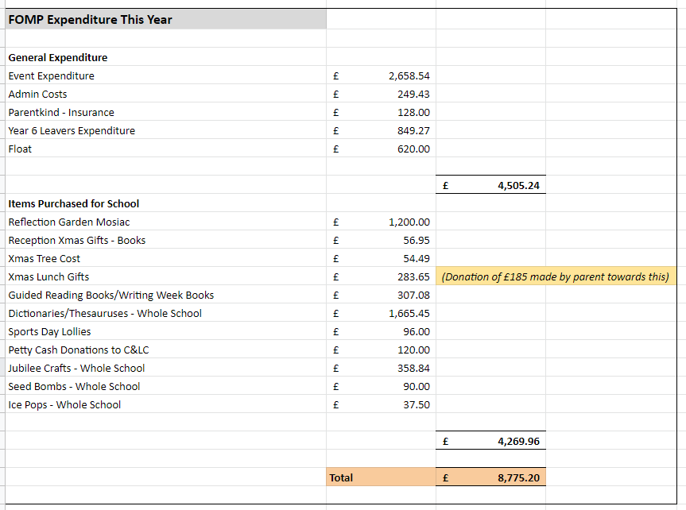

Slide 15
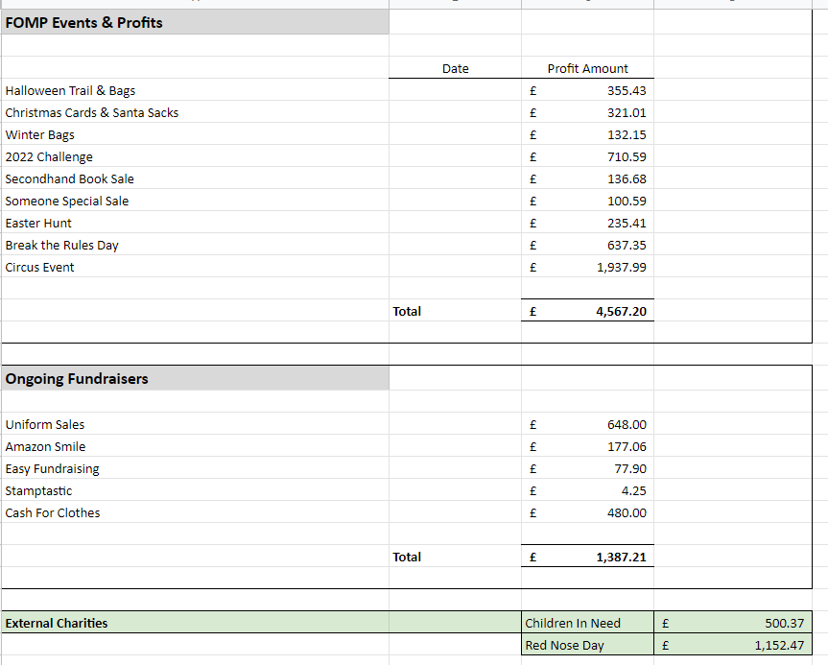

Slide 16
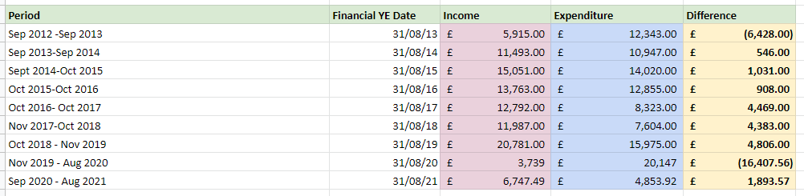

Slide 17
Committee Positions - 2022/23
Chair
Secretary
Treasurer
Ordinary Committee Member
Year 6 Leavers 2023 Event
AOB – DBS Checks Reminder for Volunteers
Closing of the Meeting

Slide 18
Thank You!!
We would like to take this opportunity to say a big thank you to everyone who has helped FOMP over the past year.
We really appreciate your continued support, and look forward to another successful year ahead!
If you would like to get involved further then please let any of the committee know or contact us at friendsofmonkfieldpark@gmail.com

